Slide 1

Why join the Coffee County ffa?
2019-2020
Mrs. Newman
Coffee County Agriculture Department

Slide 2
What is FFA?
Future Farmers of America
One of three components of agricultural education
For those interested in agriculture, leadership and having fun!
Not required, but HIGHLY recommended

Slide 3
FFA Mission
FFA makes a positive difference in the lives of students by developing their potential for premier leadership, personal growth, and career success through agricultural education

Slide 4
FFA is FUN!
FFA is NOT…
Make new friends across the state
Participate in events and activities
Serve the community as leaders
Opportunities for everyone in agriculture classes
FFA is NOT a club
FFA members are NOT just production farmers
FFA members do NOT adhere to low academic standards

Slide 5
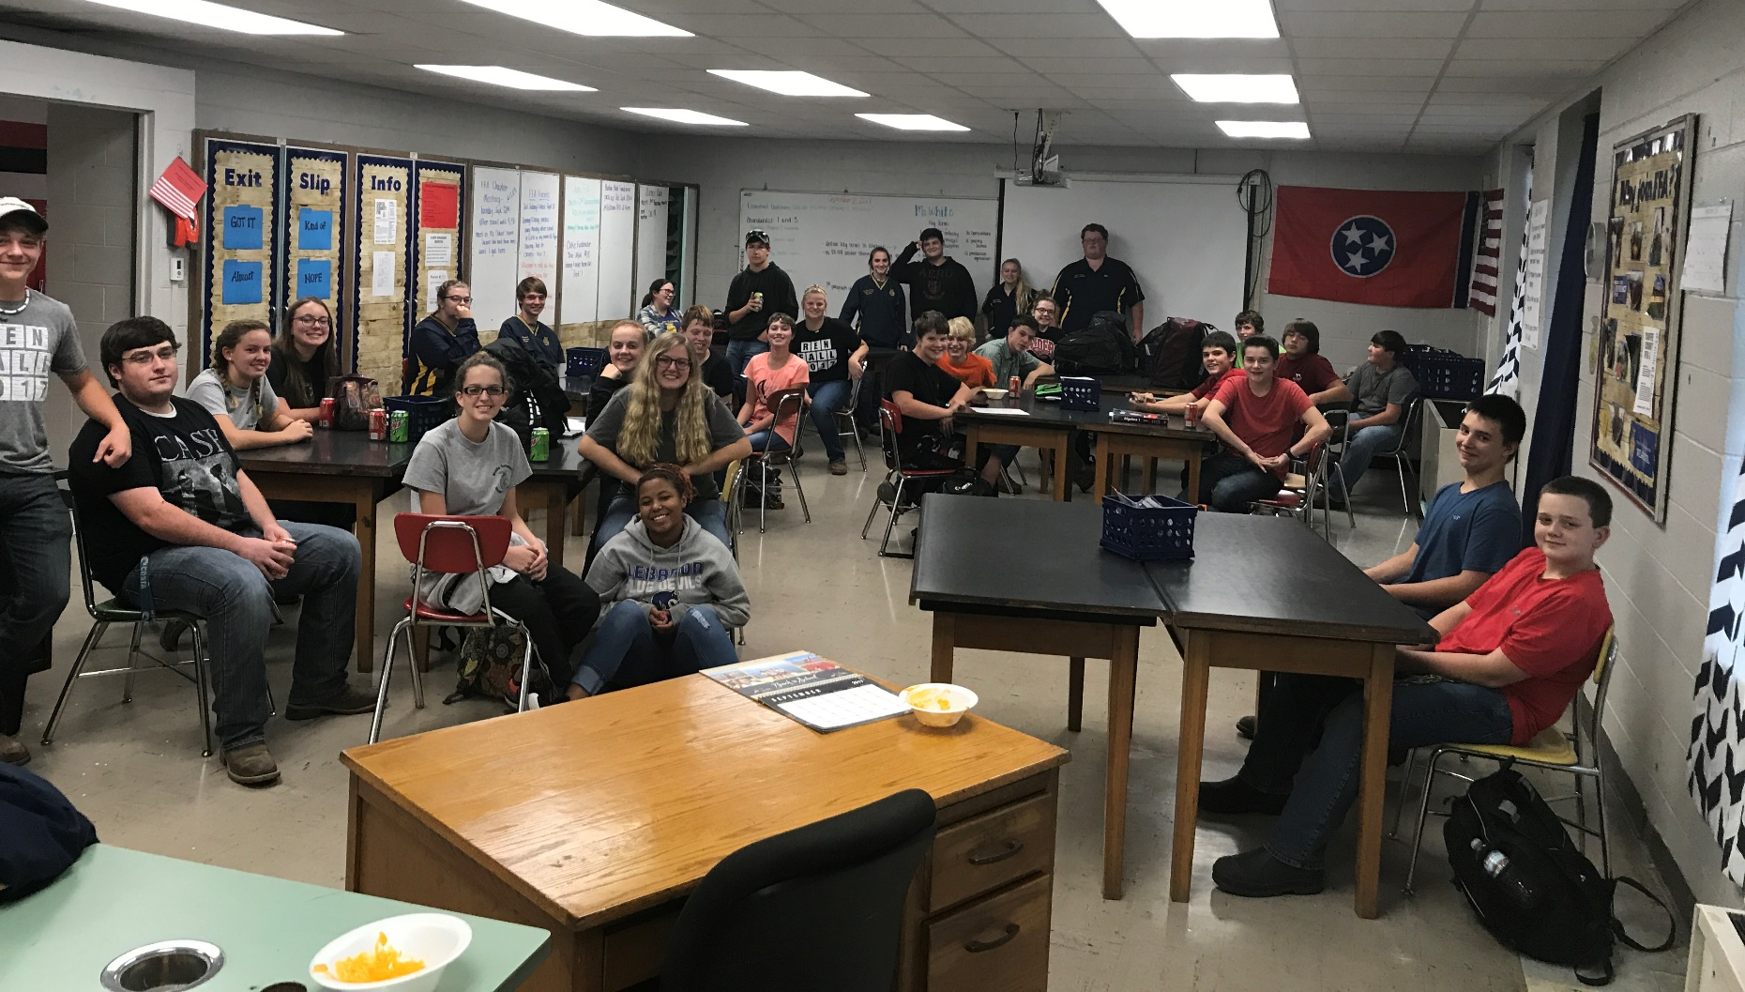
Chapter meetings 2nd Tuesday of each month
Business, food & fun!

Slide 6
2019-2020 Coffee County
FFA Officers
President- Jared Henson
Vice-President- Wren Lawson
Secretary- Callie Roper
Treasurer- Amber Ingleburger
Reporter- Brayden Davenport
Sentinel- Courtney Mullins

Slide 7
Coffee County ffa aDVISORS
Mrs. Newman- Agriscience, Natural Resources Management, and Plant and Soil Science
Mrs. Miller- Small Animal, Large Animal, and Veterinary Science

Slide 8
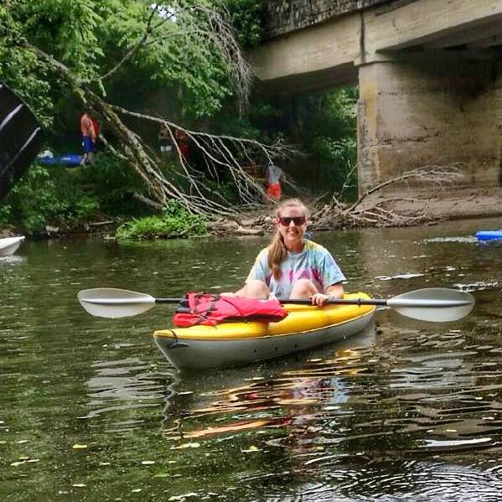
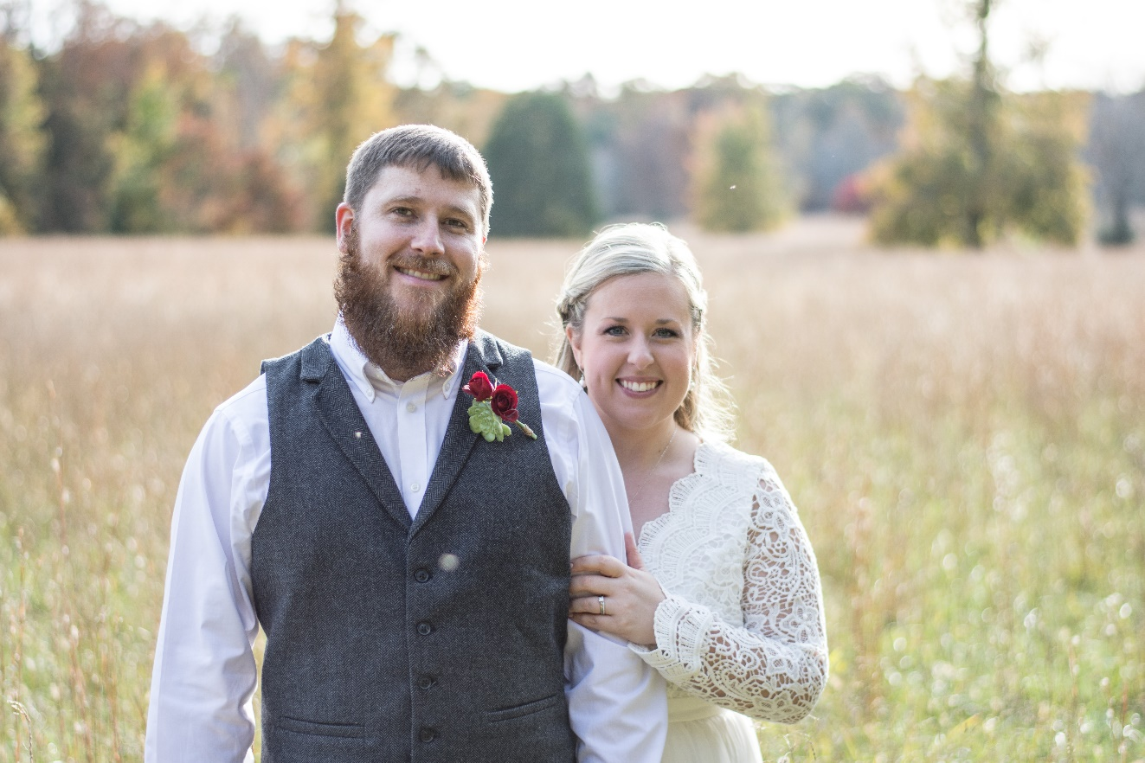
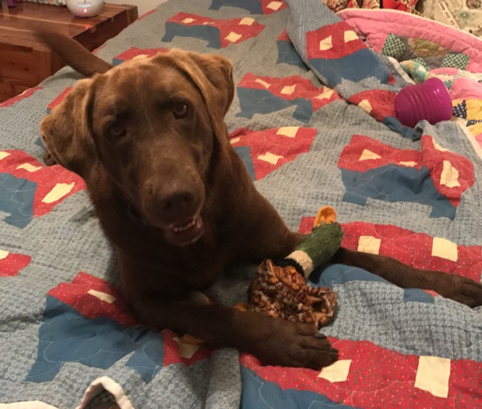
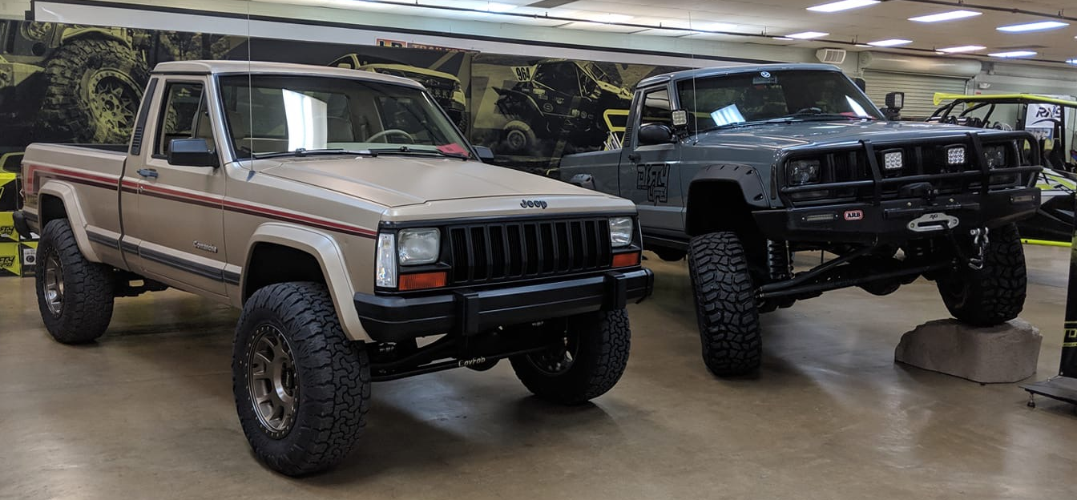
MRs. Lindsey Newman

Slide 9
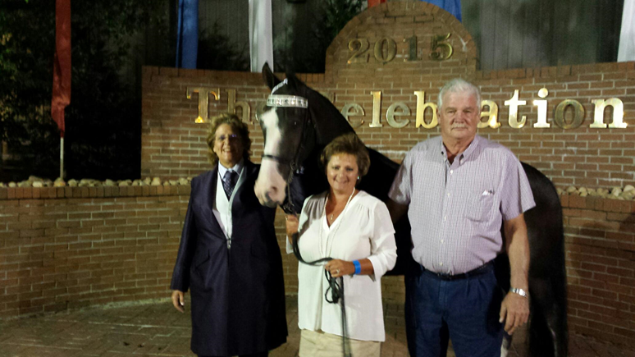
Mrs. Kim miller

Slide 10
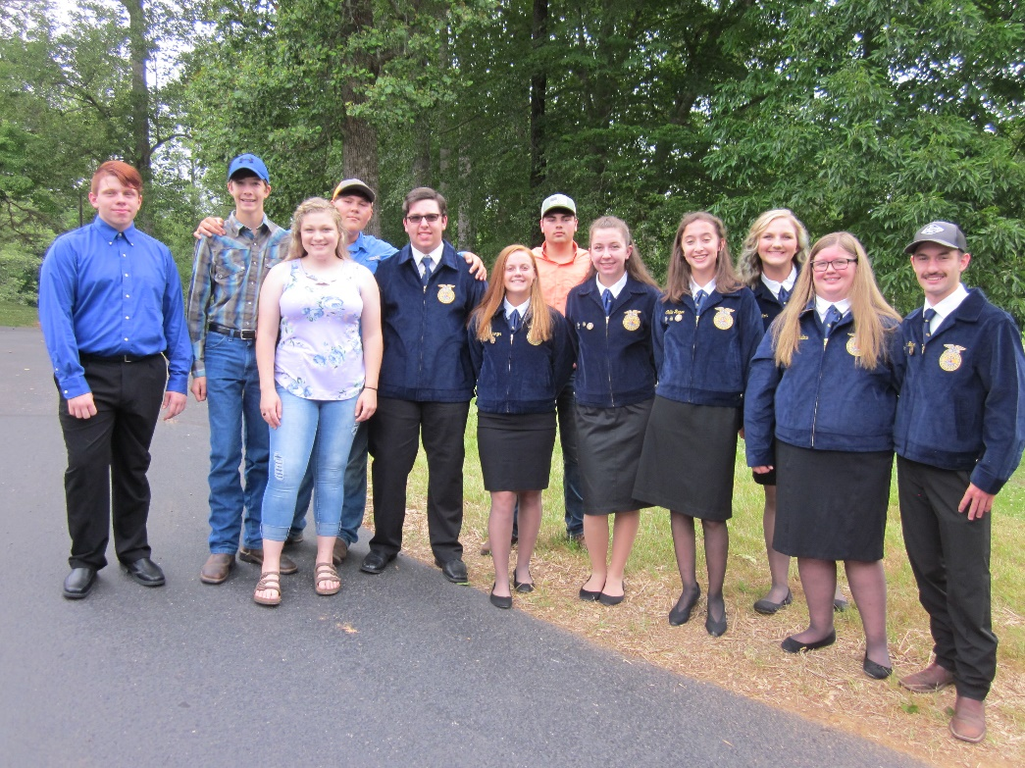
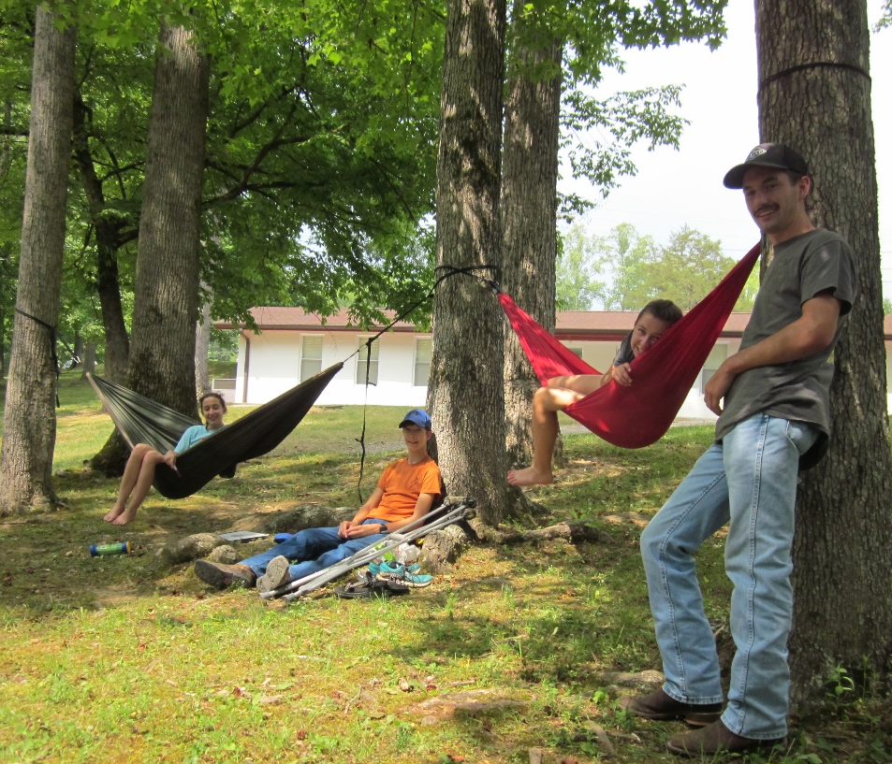
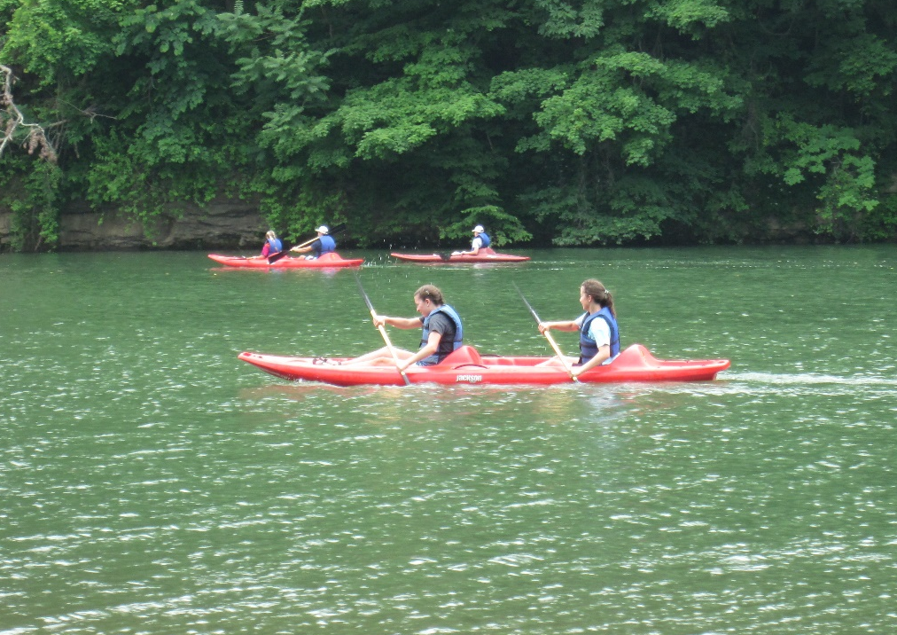
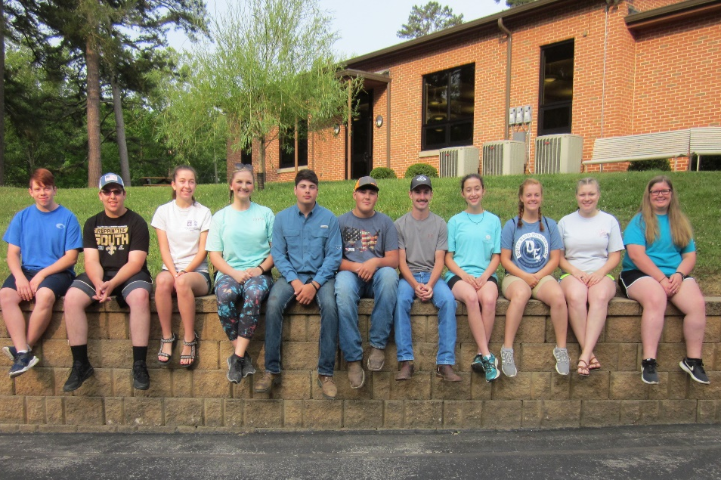
FFA Leadership Camp

Slide 11
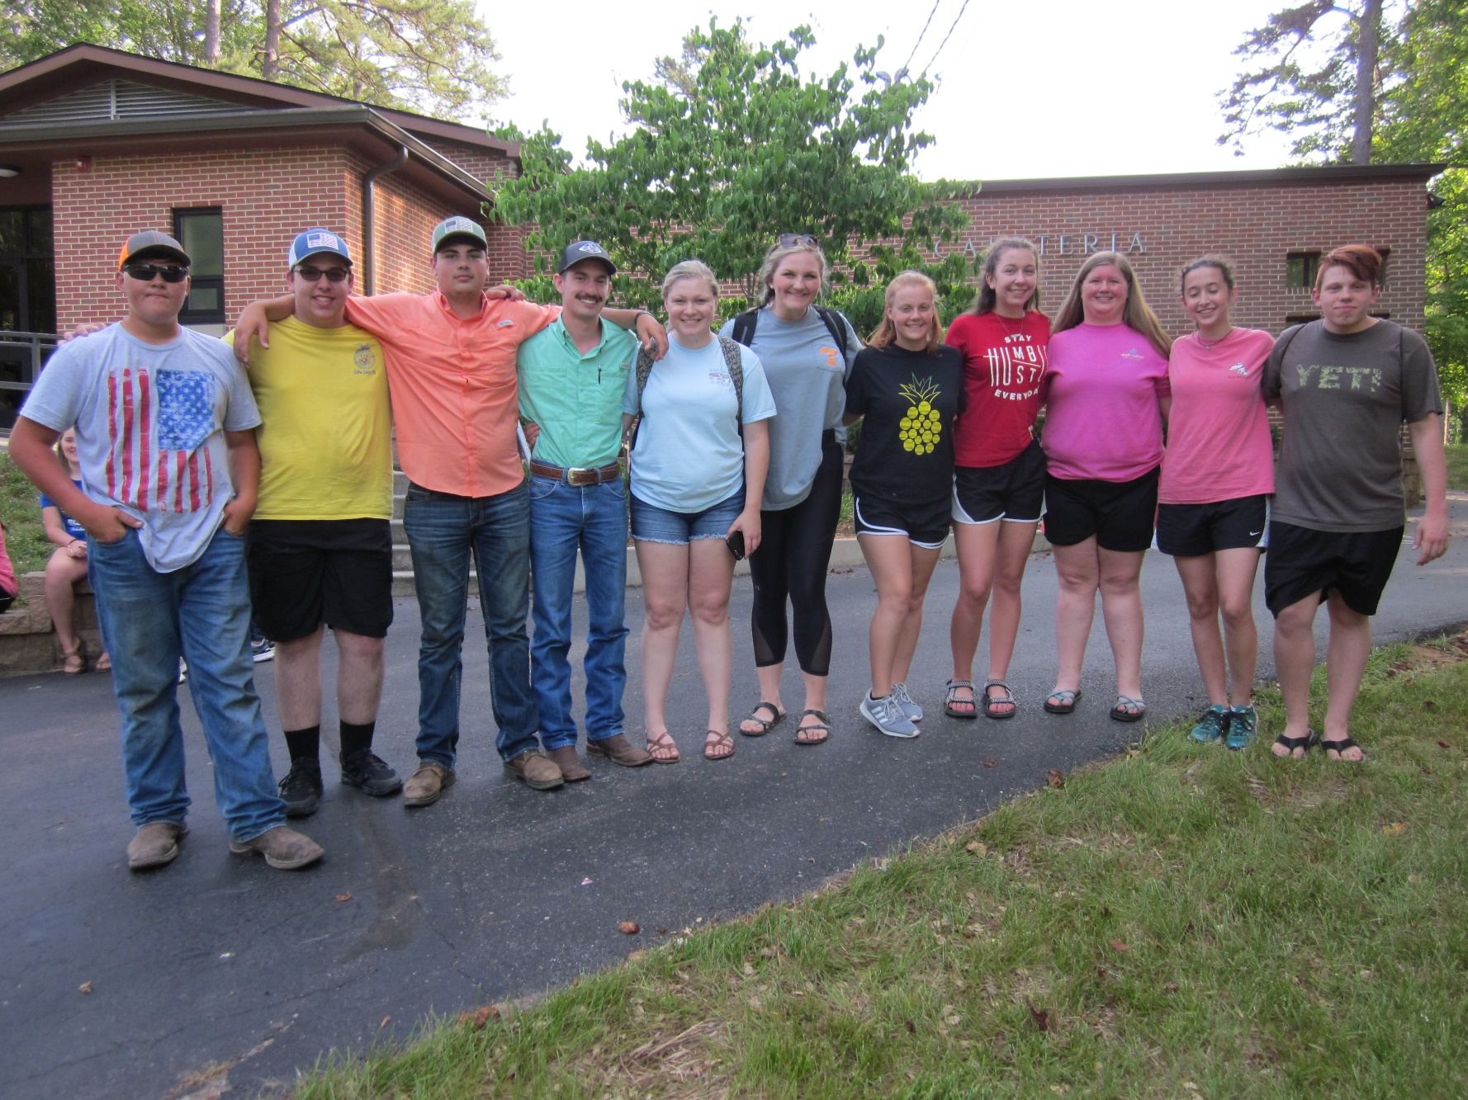
2019-2020 Coffee County FFA Officers and Members at camp

Slide 12
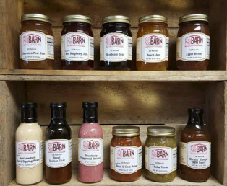


Fundraisers

Slide 13
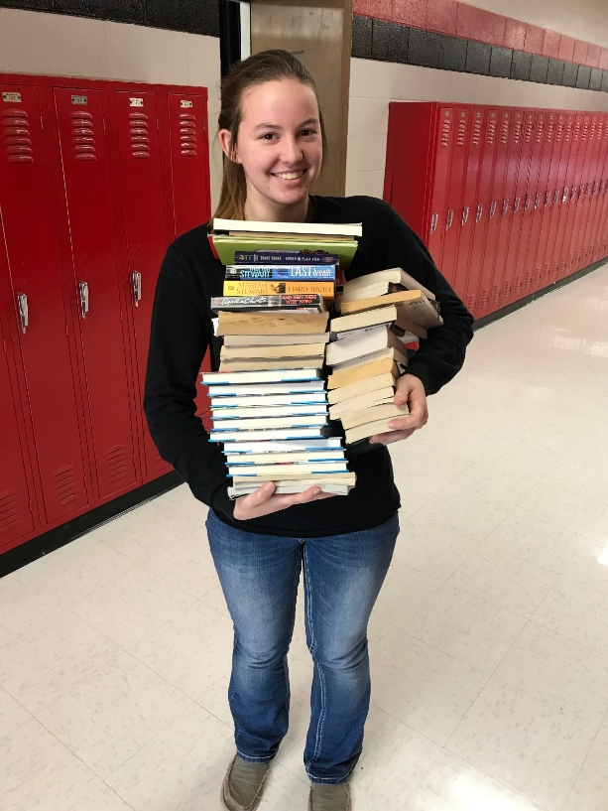
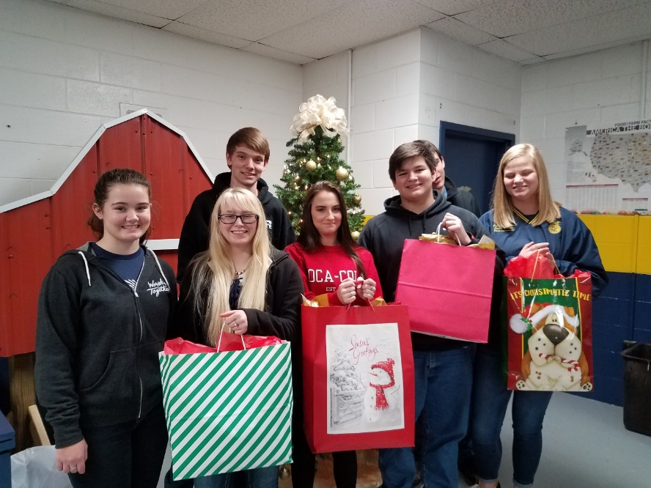
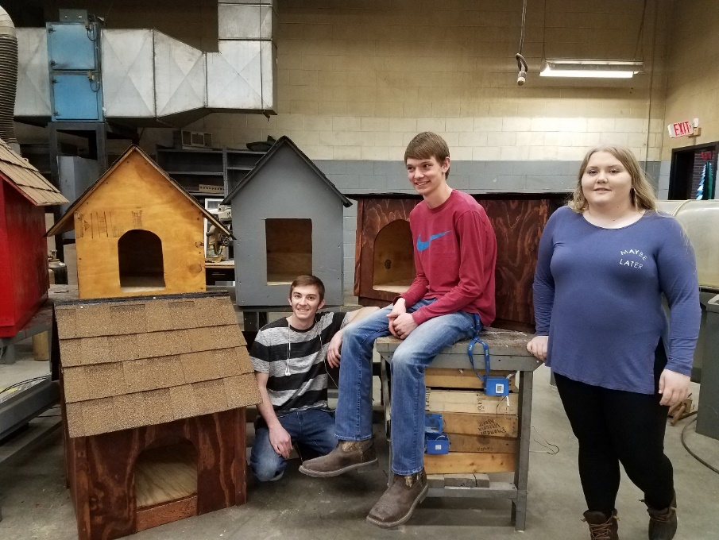
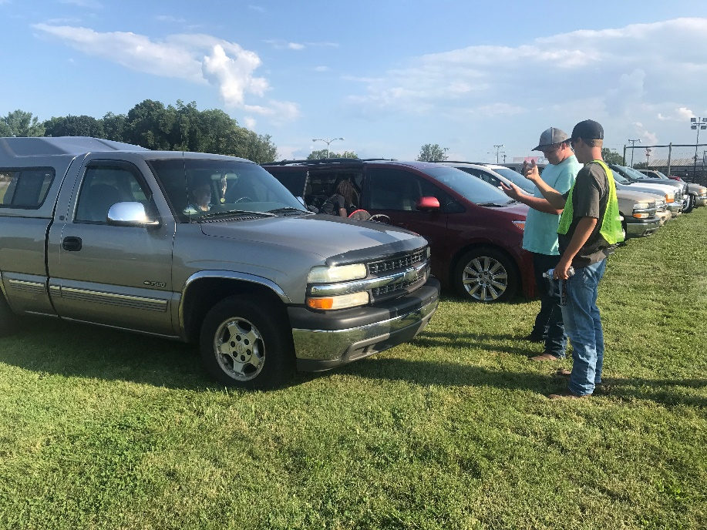
Community Service

Slide 14
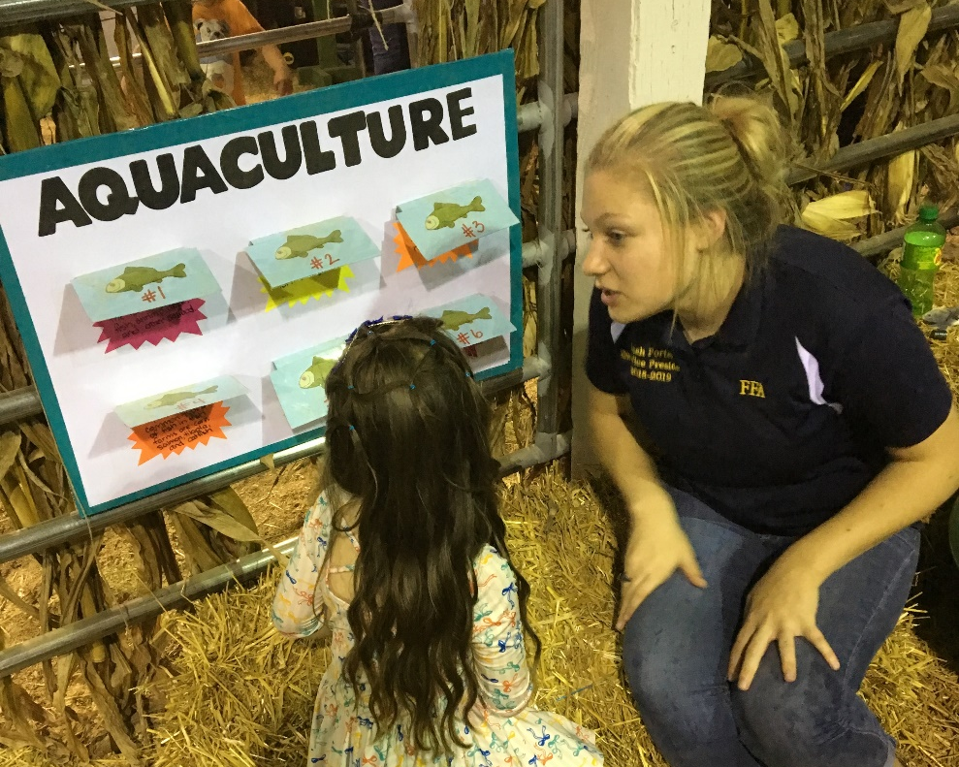
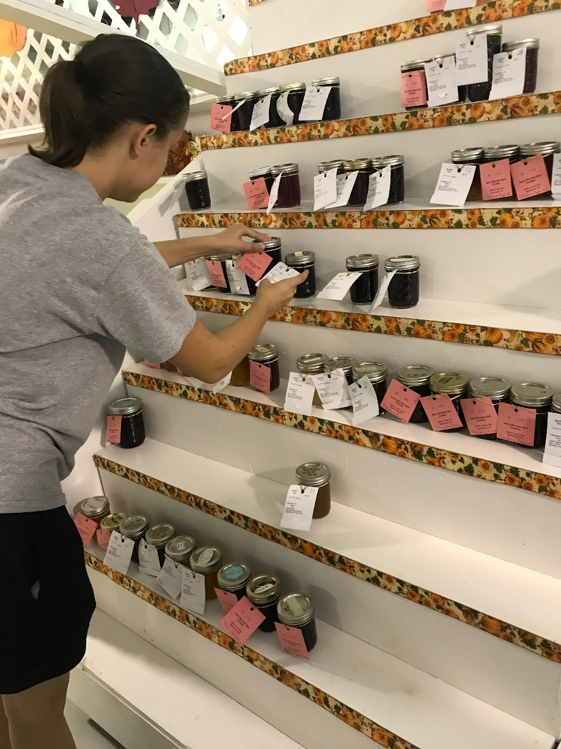
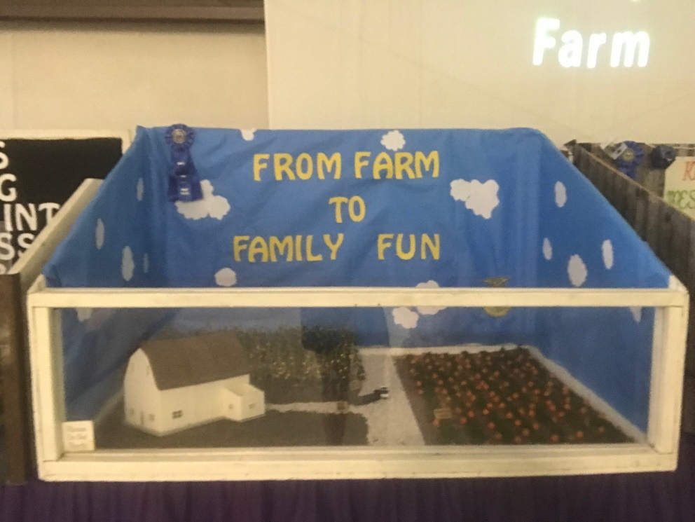
Coffee County Fair

Slide 15
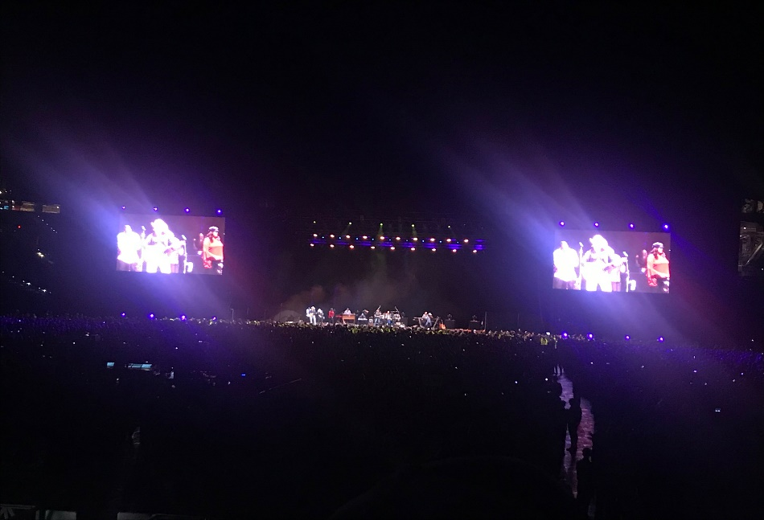
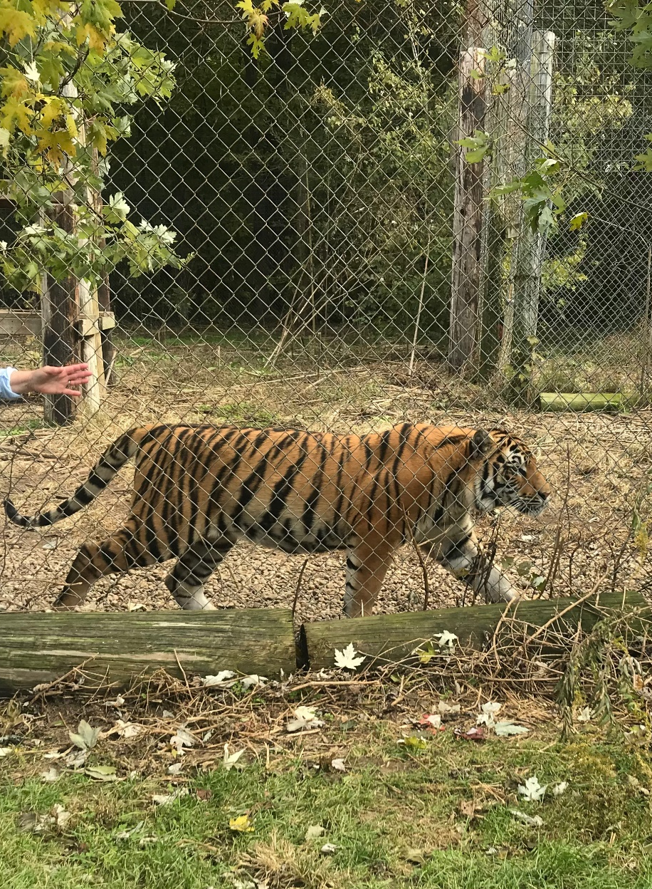
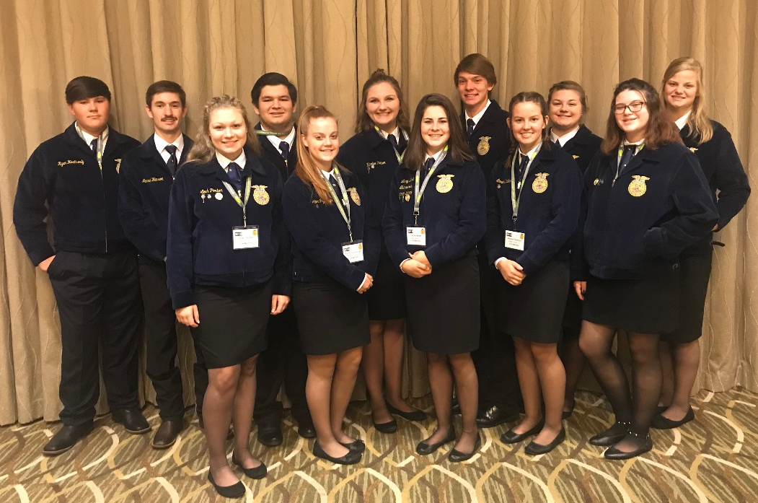
National FFA Convention
Indianapolis, Indiana

Slide 16
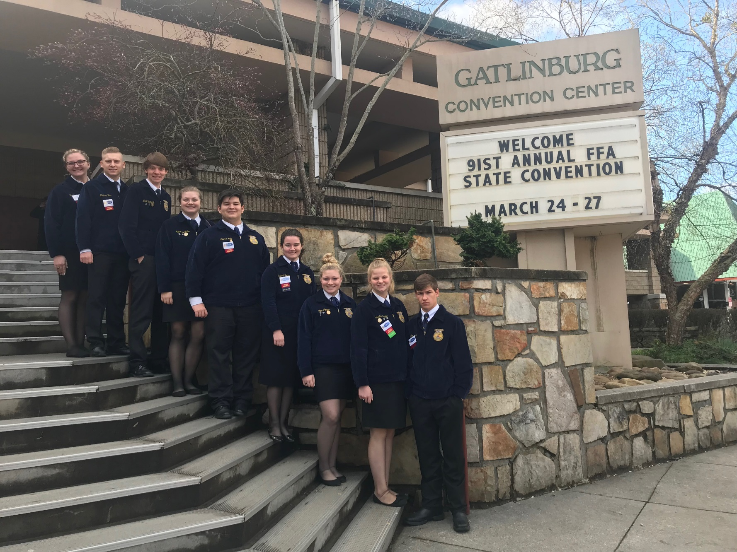
State FFA Convention

Slide 17
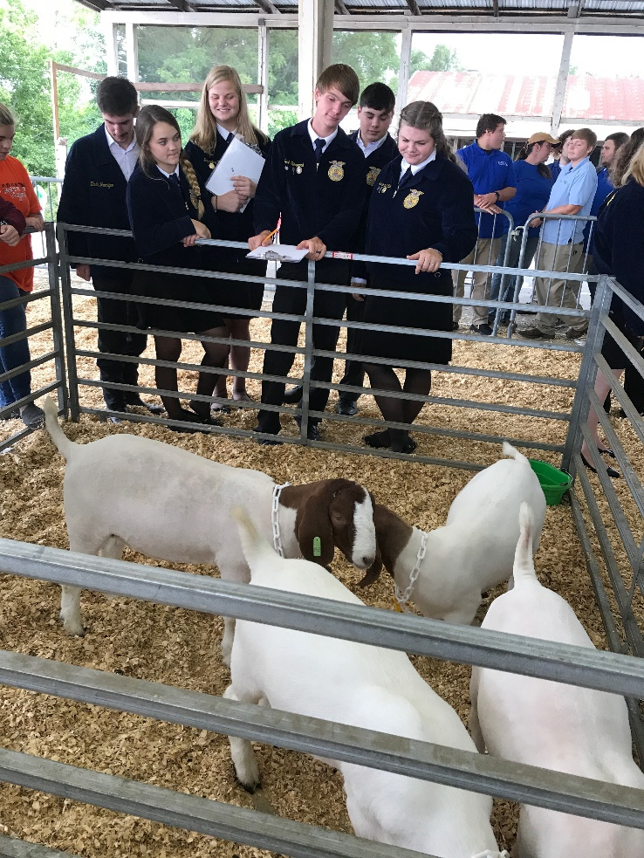
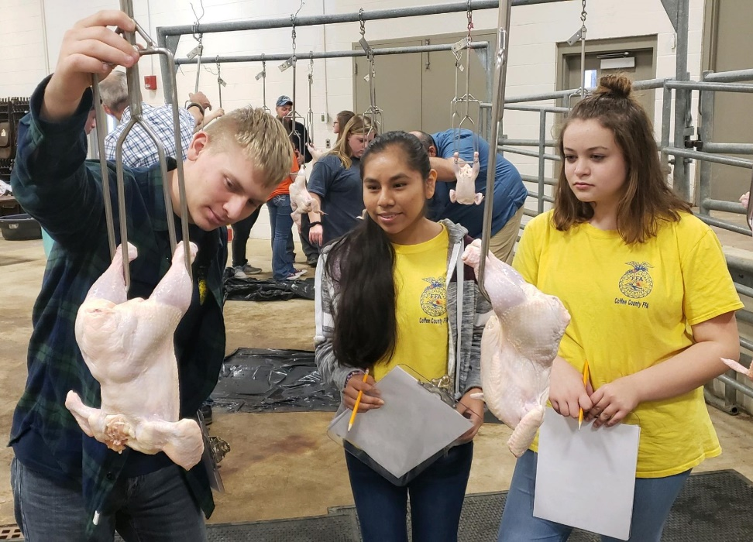
Career Development events
Each year Coffee County FFA participates in numerous career development events (CDE) or contests

Slide 18
faLL cde’S FOR Coffee co. FFA
State Horse Evaluation
  September 17 – MTSU
Land Evaluation
  September 19 – Lewisburg
Conduct of Chapter Meeting (Freshman only)
  October 24 (tentative) – Eagleville
Parliamentary Procedure (10th – 12th)
  October 24 (tentative) - Eagleville

Slide 19
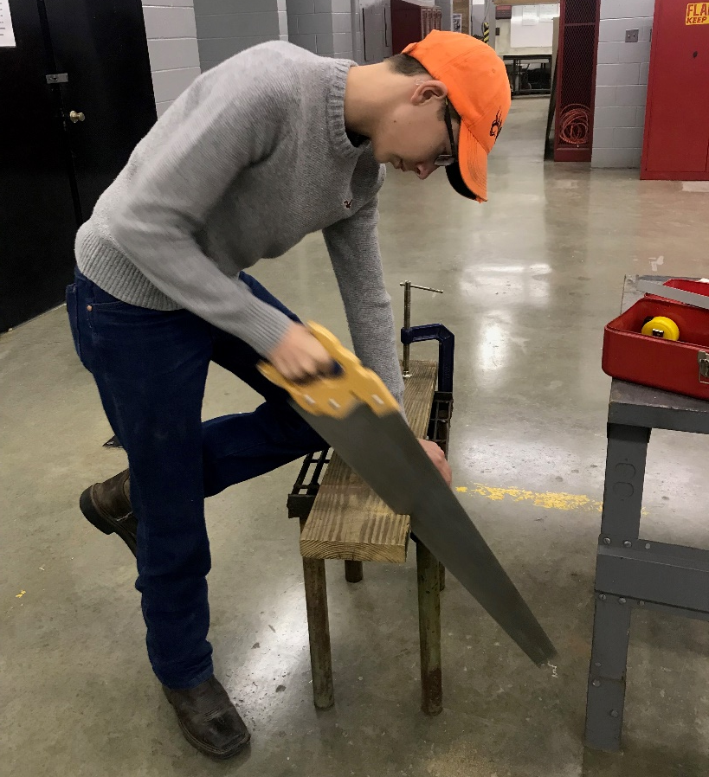
Spring CDE’s
Individual Speaking Events
  January 16 – Cascade
Agriculture Mechanics Skills
  March 5 – Shelbyville
Dairy Evaluation
  March 12 – Wilson Co. Fairgrounds
Livestock Evaluation
  April 22 – MTSU
Poultry Evaluation
  April 25 – TTU
Vet Science
  May 2 – UT Martin

Slide 20
Leadership activities
Greenhand Conference
  September 21
National FFA Convention
  October 30 – November 1
Tennessee Leadership Conference
  January 24-25
Tennessee FFA Convention
  March 24-27
Camp Clements
  June 2020

Slide 21

Any Questions? Join Today!
$30 to join – includes dues & chapter t-shirt

